Slide 1
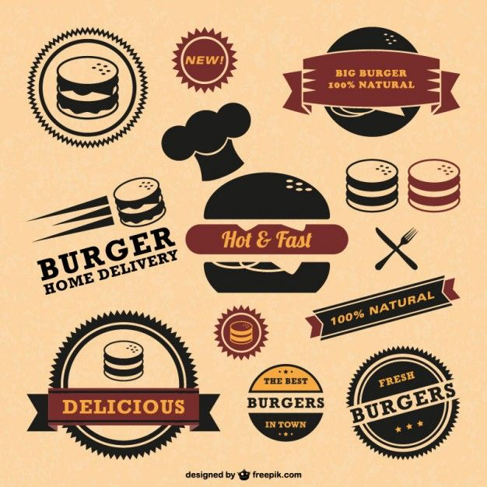

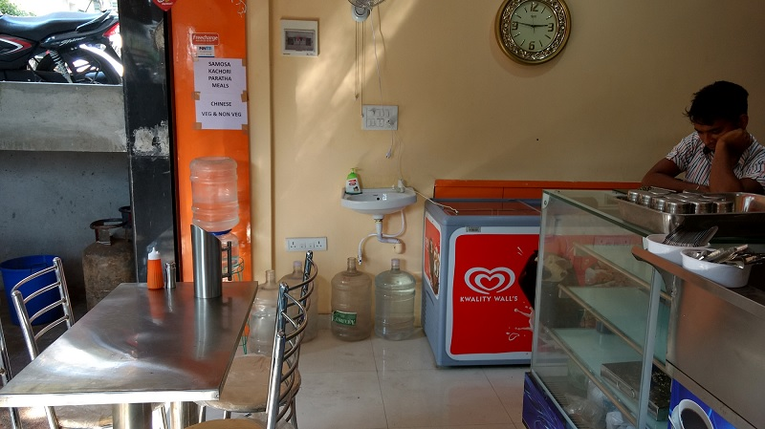
CASE STUDY
DESIGN THINKING APPROACH ON A SHOP IN BTM LAYOUT BANGLORE

Slide 2
AGENDA
Introduction
Problem Statement
Objective of the survey
Data source
Research Design/Approach and Analysis
Solution description
Impact

Slide 3
INTRODUCTION
BTM (Begur, Taverekera and Madiwala)layout is a neighborhood in south of Bengaluru. Its official name is Kuvempunagara.
It has a population of 7,13,942 and is close to Jayanagar, Jp Nagar, Bannerghatta Road, Tilaknagar, Taverekera and Madiwala making it one the popular residential areas in Bengaluru.
BTM layout is, in fact, the brainchild of the Bangalore development authority (BDA). Its precise layout, along with excellent urban infrastructure has served as a catalyst to its growth. It is is noted for its cafés, boutiques and music venues. It is home to renowned educational institutions and hospitals.
Having so many attraction of the localities many foodie are also seen wandering for different and good quality food. As per category and pricing the location has seen phenomenal number of fast food centers in every crossing

Slide 4
PROBLEM STATEMENT
A man has took a shop in rent near BTM layout bangalore not in the main road but as a local shop.
In the first 3 months he make a profit of around 100000, with a sales of around 300000.
In the 1stmonth he was selling veg food also, but he stopped after the 2ndmonth as it stock was not getting out
After 4 –5 months down the line the man is making a huge loss in his investment.
He has a due of 2 months to pay the rent.
The sale has drastically gone down and he is thinking to close the shope.
The man is very lazy in working hard and also very poor in any other investment

Slide 5
OBJECTIVE OF THE SURVEY
To see the pit holes as to why the shop was running loss
To see how to increase the sale
To keep a check on waste management
To keep a track of customer focus ,requirement and satisfaction
To bring out solution to overcome the loss and make it a profitable shop

Slide 6
DATA SOURCE
In this case study ,data collection technique was used and the data was collected from different food delivery applications like SWIGGY ,ZOMATO
The collected data was processed in Microsoft excel sheet and analysed on different parameters.
The valuable feedbacks of the customers were also analysed in order to make it a profitable shop

Slide 7
ANALYSIS
PERSUALS:
The sale in first quarter was drastically increasing and was expected to go high.
The monthly income in first quarter lead to a profit of 100000

Slide 8
ANALYSIS
PERSUALS:
The sale in the next months started to fall
The expected trend line shows a further fall in the sale figure
PERSUALS:
The income in the next months shows a downfall leading to loss

Slide 9
ANALYSIS
PERSUALS:
In the first quarter the income was more than the expenditure which lead to profit
In the next months the income started to decrease with increase in expense leading to loss

Slide 10
Reason for failure
MENU CARD:
Less number of choice in food item as the people always want options
Removing veg item which lead to bypass the vegetarian customers
QUALITY AND QUANTITY
The quality was good in the first few month but detreated with time
Fresh stocks were also not maintained
Overstocking the items led to loss
COMPLAINT SOLUTION:
They did not redress the complaint of the customers
Feedback plays avery important role in making a business a success which they did not keep an eye
NEW ITEMS/ ADD ONS AND COMBOS
There was no new items added in menu in the last 4 month
Combo packs and add on were not included in the list
Special offers for students or groups were not entertained
No festive offers were given
HYGINE AND SERVICE
“Cleanliness is next to godliness “ plays a vital role in such type of business which was not maintained
Staff were not polite enough with their services’
Shop branding is one of the most important part which was not done including home delivery

Slide 11
SOLUTION description
Must add food item as per the demands and trend of customers choice.
Adding vegetarian verities will attracts vegetarian customers.
Combo packs and add on should be included .
Special offers like students offer/ party offer/ festive offer should be introduced.
The quality and quantity and cleanliness should be maintained to provide a friendly environment .
An idea of transparent kitchen attracts customers as they can see what is being used for preparation.
A proper stock maintenance based on budget and demand should be maintained so that it does not lead to over expense.
Staff should be well trained to tackle the customers requirements complaints and feedback.
Use of technology to get orders, maintain stocks ,will help in easy stock control and capital analysis.
Use of digital marketing to advertise in different social media platforms will attract the youth.
Keeping a track of customers and providing coupons and vouchers will help in growing the chain of business.
Introducing home delivery system and customer loyalty program will add icing on cake to the solution.
Waste management program should be followed.

Slide 12
Impact
Adding items to the menu will attract the customers as they will frequently visit to taste new items
Combos/offers always attracts the youth and will increase permanent customers
Keeping a track on waste management will not lead to wastage of food item as it is the most precious gift of god
Use of technology will help in proper stock control and capital analysis
Advertising and branding will lead to publicity of business and will attracts a large group of media users
Keeping an eye on feedbacks will help in improvement of business
A customer loyalty program will add on and complete the growth trend of business

Slide 13
THANK YOU
Nitesh Kumar Sharma

